Slide 1
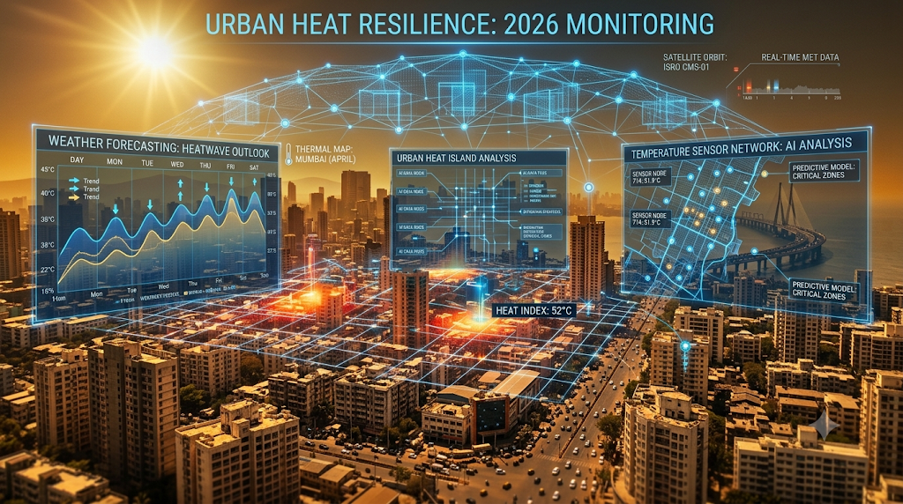
Title: Heat Wave Response, Recovery, Future Challenges, and the Role of Technology Subtitle: A Ground-Level Assessment and Preparedness Study
Submitted To: India Space Lab (ISL), New Delhi
Student Name: Bhosale Pranali Pravin
Institute: DKTE Society's Textile & Engineering Institute
Roll No: 24UET320
Enrollment No: ISL-578965

Slide 2

Project Objectives
Primary Objectives:
Analyze root causes and public health impacts of extreme heat events.
Evaluate current heat wave response and post-event recovery measures.
Identify long-term climate risks and technological intervention strategies.
Secondary Focus:
Map vulnerable demographics and Urban Heat Island (UHI) effects.

Slide 3
Study Area & Research Methodology
Study Area: Heat-prone urban and rural zones in Maharashtra.
Methodology:
Primary Data: Field observations, temperature tracking, and vulnerability matrices.
Secondary Data: IMD weather datasets, NDMA Heat Action Plan policies, and municipal records.
Analytical Tools: GIS mapping concepts, Landsat satellite thermal band analysis.

Slide 4
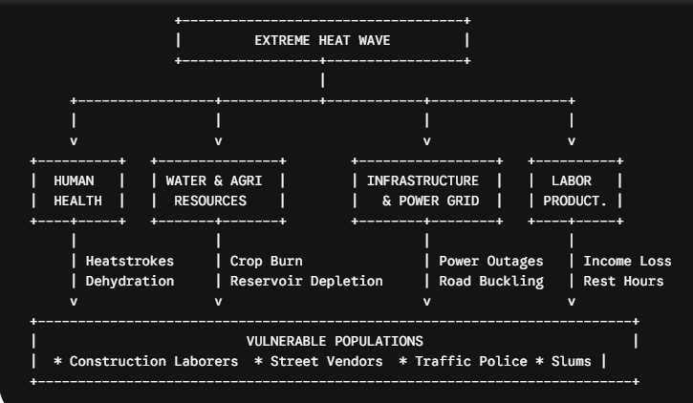
Vulnerable Demographics
Outdoor Manual Laborers: Construction workers, agricultural labor, traffic police, sanitation staff.
Informal Workers: Street vendors, auto-rickshaw operators.
Sensitive Groups: Elderly citizens, infants, pregnant women.
Informal Settlements: Dense slum communities with uninsulated roofing and poor ventilation.

Slide 5
Heat Wave Response Mechanisms
Early Warning Dissemination: Color-coded IMD alerts (Yellow, Orange, Red) via SMS and media.
Public Cooling Infrastructure: Temporary shade shelters (Pandals) at transit centers.
Hydration Facilities: Public drinking water kiosks (Pyaaos) and ORS packet distribution.
Emergency Medical Care: Dedicated hospital heat-stroke wards and ambulance deployment.

Slide 6
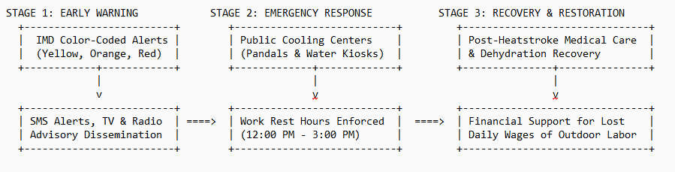
Recovery & Economic Mitigation
Public Health Recovery: Patient post-heatstroke monitoring and medical follow-up care.
Livelihood Support: Social protection policies for daily-wage workers facing lost workdays.
Resource Restoration: Emergency municipal water supply routing and livestock heat stress mitigation.

Slide 7
Future Climate Challenges
Intensifying Climate Risks: Prolonged summer durations and rising peak temperatures.
Urban Heat Island Expansion: Concrete density retaining high night-time surface radiation.
Infrastructure Strain: Power grid overloads due to cooling demand and severe water table depletion.
Economic Productivity Loss: Decline in daily outdoor physical work output.

Slide 8
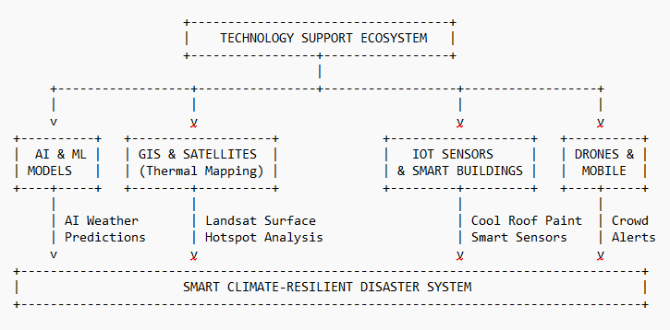
Role of Modern Technology
AI & Forecasting: Machine learning models for micro-climate risk predictions.
GIS & Remote Sensing: Satellite surface thermal band mapping to locate urban hotspots.
IoT & Sensors: Automated hyper-local weather sensors and smart irrigation networks.
Smart Infrastructure: Cool roof paints, reflective pavements, green roofs, and thermal drones.

Slide 9
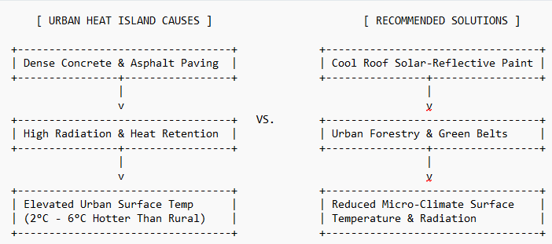
Key Recommendations
Cool Roof Policy: Mandate high-albedo solar-reflective paint on low-income homes and public buildings.
Urban Forestry Expansion: Create green shelter belts along major roads and urban centers.
IoT Sensor Networks: Deploy local micro-climate monitoring nodes across municipal districts.
Labor Protection Laws: Enforce mandatory afternoon work pauses during Orange/Red alerts.

Slide 10
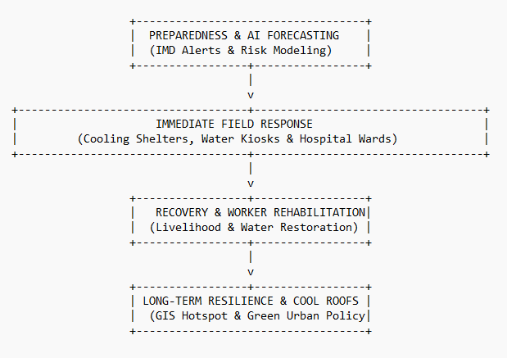
Conclusion
Integrated Disaster Resilience: Transition from short-term emergency response to long-term proactive planning.
Technology as a Force Multiplier: Leveraging GIS, AI, and IoT to protect public health and urban infrastructure.
Sustainable Future: Building smart, climate-resilient cities for vulnerable populations.

